Slide 1

Elementary and Secondary School Emergency Relief (ESSER) Roundtable Series:
SEL/Mental Health/NJTSSS
Division of Educational Services
March 16, 2022

Slide 2

Using Microsoft Teams
  Chat
    We welcome your participation in discussions by asking questions and adding comments in the chat box.
  Raise Hand
  Please use the raise hand feature if you want to speak.
  Mute/Unmute
    Please remain muted whenever you are not speaking.

Slide 3
Agenda
Housekeeping Dr. A. Charles Wright, Executive Director/Deputy Assistant Commissioner Division of Educational Services
Welcome Ms. Kathy Ehling, Assistant Commissioner, Division of Educational Services
SEL/MH/NJTISS Mr. Luiz Pereira, Acting Director, Office of Student Support Services
District Presentations Paramus Public Schools
District Presentations South Amboy Public Schools
District Presentations Burlington City Public Schools

Slide 4
Welcome

Slide 5
NJTSS/SEL/Mental Health

Slide 6
New Jersey Tiered System of Supports (NJTSS)

Slide 7
NJTSS and Intervention & Referral Services (I&RS)
6A:16-8.1 Establishment of intervention and referral services
  District boards of education shall establish and implement in each school building in which general education students are served a coordinated system for planning and delivering intervention and referral services designed to assist students who are experiencing learning, behavior, or health difficulties, and to assist staff who have difficulties in addressing students’ learning, behavior, or health needs. District boards of education shall choose the appropriate multidisciplinary team approach, such as the Response to Intervention (RTI) or a Multi-Tiered System of Support (MTSS) model, for planning and delivering the services required under this subchapter.

Slide 8

NJTSS: Defined
New Jersey Tiered System of Supports: A framework for supporting the academic, behavioral, social-emotional and health needs of all students through a layered continuum of evidence-based practices, interventions and services.

Slide 9
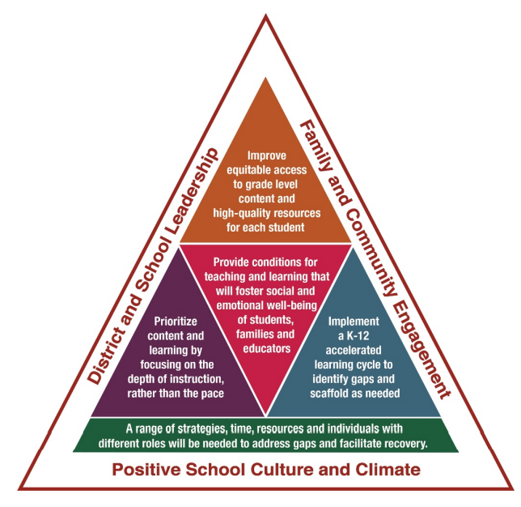
NJTSS & Learning Acceleration
NJTSS works hand in hand with Learning Acceleration to ensure our students are exactly where they need to be.

Slide 10
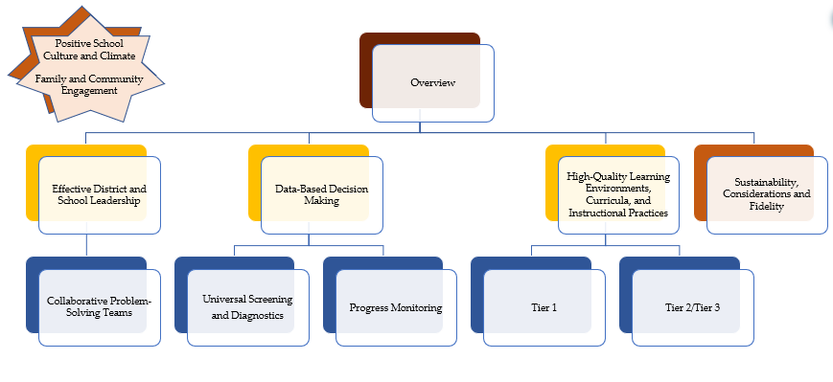
Getting Started Series: New Jersey Tiered System of Supports

Slide 11


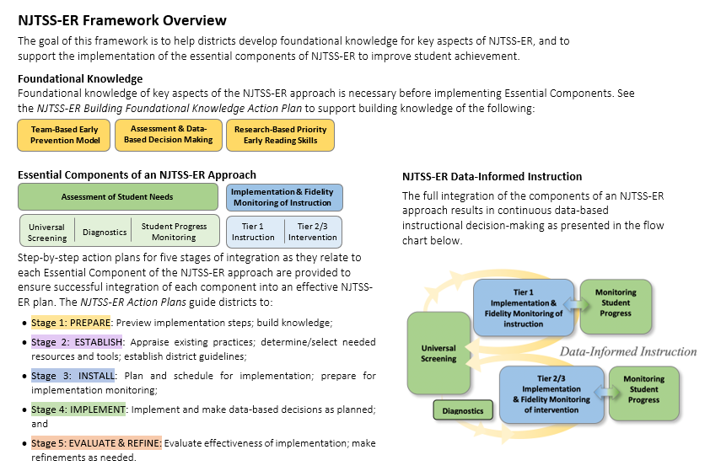
NJTSS for Early Reading

Slide 12


Under Development
NJTSS
  Getting Started Series of presentations
  Data-based Decision-Making for Addressing Chronic Absenteeism
SPAN Roundtable Presentation
  Getting it Right: Using Assessment to Guide Instruction for ALL Students
NJTSS-ER
  Framework, Action Plans, Learning Modules

Slide 13
Social & Emotional Learning (SEL)

Slide 14
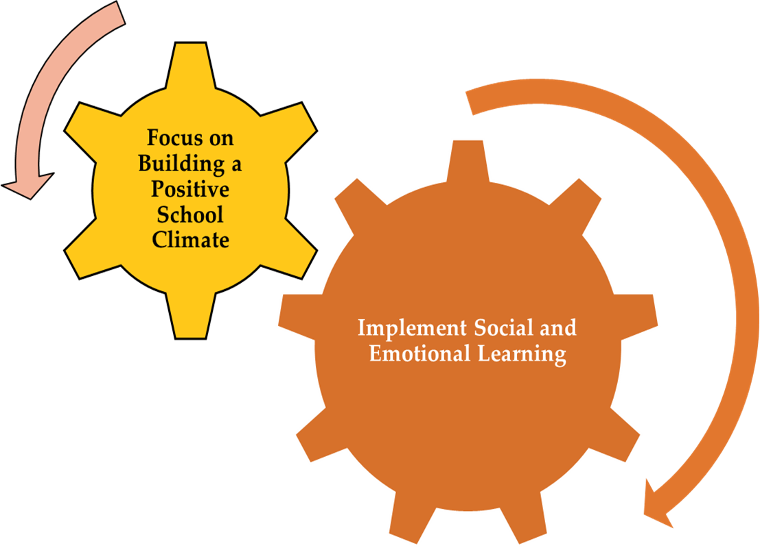
Essential Strategies for Supporting SEL in Schools

Slide 15
Social & Emotional Learning
Social and emotional learning (SEL) is the process through which all young people and adults acquire and apply the knowledge, skills and attitudes to:
  Develop healthy identities;
  Manage emotions;
  Achieve personal and collective goals;
  Feel and show empathy for others;
  Establish and maintain supportive relationships; and
  Make responsible and caring decisions.
Source: Collaborative for Academic, Social, and Emotional Learning

Slide 16
New Jersey Social and Emotional Learning
Competencies and Sub-Competencies
Self-Awareness
Self-Management
Social Awareness
Responsible
Decision-Making
Relationship Skills
Recognize
one’s feelings
and thoughts
Recognize
the impact of
one’s feelings and thoughts on one’s own behavior
Recognize
one’s personal
traits, strengths
and limitations
Recognize
the importance
of self-confidence
in handling daily tasks and
challenges
Understand
and practice
strategies for
managing one’s own emotions, thoughts and behaviors
Recognize
the skills needed
to establish and achieve personal
and educational
goals
Identify
and apply ways
to persevere or
overcome barriers through alternative methods to achieve one’s goals
Recognize
and identify the thoughts, feelings
and perspectives
of others
Demonstrate
and awareness of the differences among
individuals, groups and others’ cultural backgrounds
Demonstrate
an understanding
of the need for
mutual respect
when viewpoints
differ
Demonstrate
an awareness of
the expectations for
social interactions
in a variety of settings
Develop,
implement, and
model effective
problem solving
and critical
thinking skills
Identify
the consequences
associated with one’s actions in order to make constructive
choices
Evaluate
personal, ethical, safety and civic
impact of decisions
Establish
and maintain healthy relationships
Utilize positive communication and social skills to interact effectively with others
Identify
ways to resist
inappropriate
social pressure
Demonstrate
the ability to
prevent and resolve interpersonal conflicts in constructive ways
Identify
who, when, where,
or how to seek help for oneself or others when needed
*Adopted by the New Jersey State Board of Education in August 2017

Slide 17
SEL is Supported by Research
Students in schools that explicitly & consistently implemented SEL:
  Were more likely to attend school.
  Were less likely to have conduct problems.
  Received better grades.
  Were less likely to engage in high-risk behaviors.
  Felt more connected to school.

Slide 18
New Resource for Schools
SEL Professional Development Modules
Support School Districts to Provide Professional Development on SEL
Materials Designed to Be Flexible and Can Be Used in any School
Promotes Development of Adult SEL Skills
Module 1: Overview of SEL.
Modules 2-6: Deep dive into each
SEL Competency.
Each module contains:
  Facilitation guide.
  PowerPoint presentation that
  can be customized.
  Hand-Outs.
Use individually, with a partner, in a PLC, or a large group.
Materials can be easily separated into multiple sessions.
Content relevant to educators of students of all ages and abilities.
Includes self-assessment and self-reflection activities.
Application of knowledge through vignettes and videos.
Action planning tools that
support classroom, school, and
district efforts to implement SEL.

Slide 19
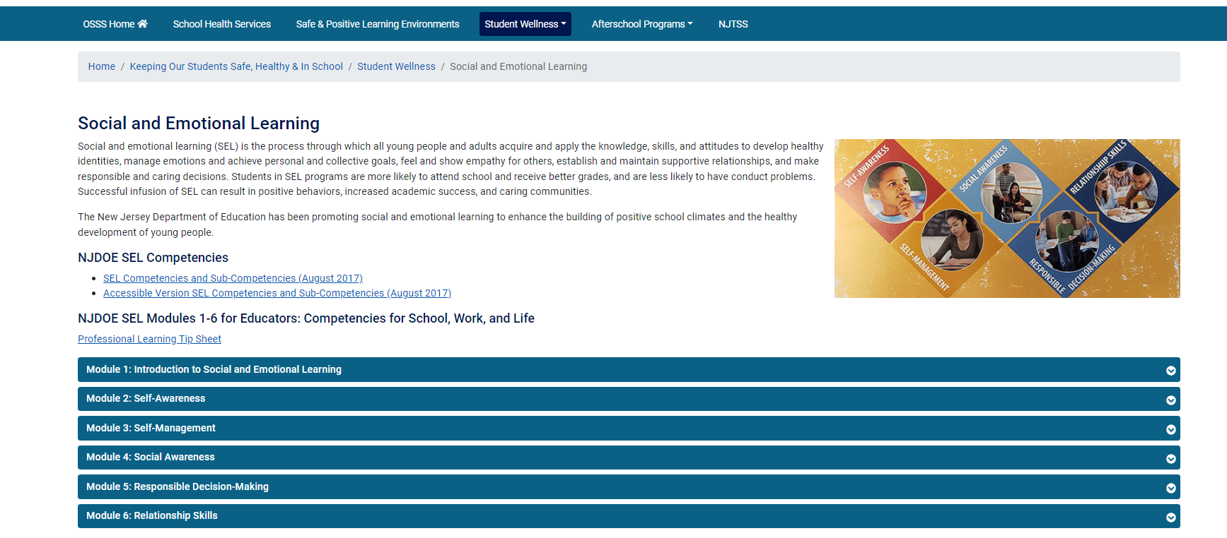
NJDOE SEL Website

Slide 20
School Climate
Quality & character of school life.
Based on patterns of students’, parents’ and school personnel’s experiences of school life.
Reflects norms, goals, values, interpersonal relationships, teaching and learning practices and organizational structures.
Source: National School Climate Center

Slide 21

Piloting a Resource for School Districts

Slide 22
NJ SCI Survey Domains
The NJ SCI Survey includes stakeholder-specific questions on the below topics.
Staff/Families Only
All Stakeholders
Family Support and Engagement.
Schoolwide Academic Culture.
Adult-Student Relationships and Supports.
Supports for SEL.
Behavior Management.
Student Interpersonal Behaviors: Negative.
Student Interpersonal Behaviors: Prosocial
and Inclusive.
Student Voice and Involvement.
Safety.
Staff Only
Leadership Support.
Organizational Structures and Supports.
Adult Social and Emotional Environment.
Students Only
Classroom Instructional Practices.
Student Sense of Belonging.

Slide 23
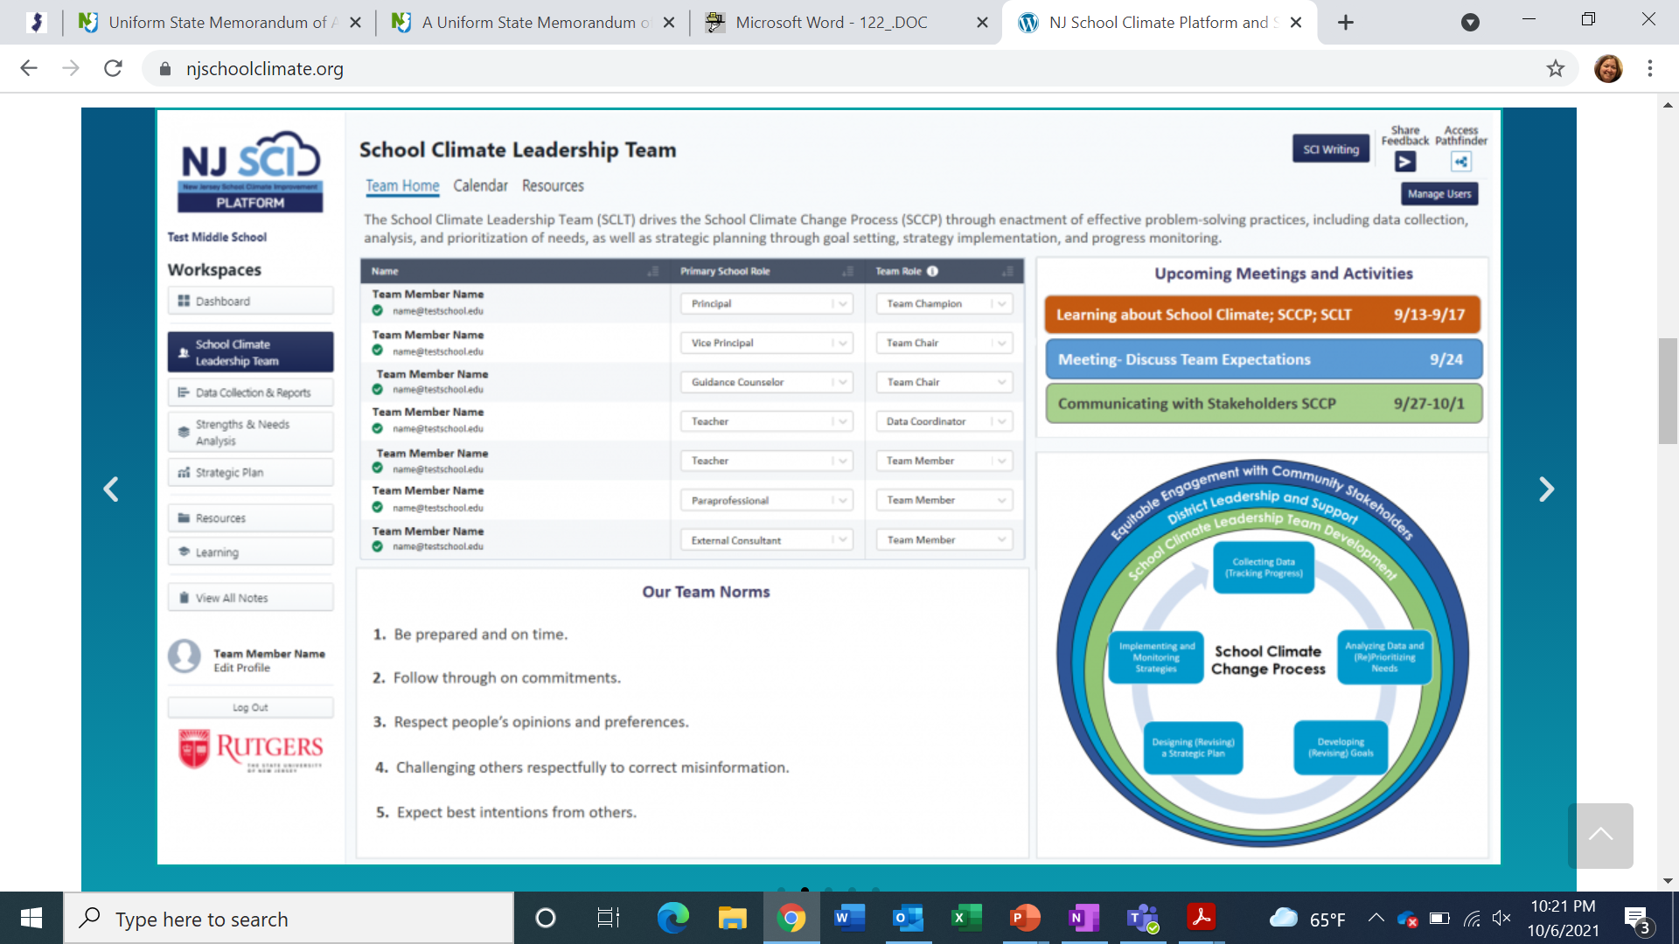
NJ School Climate Improvement (NJ SCI) platform

Slide 24
Resource for Schools: Webinar on Trauma-Informed Learning Environments
Overview of adverse childhood experiences (ACEs) and toxic stress.
Overview of positive childhood experiences and how these experiences of connection can buffer effects of ACEs, build resilience, and foster healing.
Learn tools and techniques that help build resilience in adults and students.
Sign up on NJDOE Calendar of Events

Slide 25
Additional Information
NJ SCI Survey & Platform: NJSchoolClimate.org
SEL Resources: NJDOE SEL Website
Questions can be sent to SafeSupportiveSchools@doe.nj.gov

Slide 26

Youth Mental Health

Slide 27

Mental Health Resource Guide
The well-being of our children and youth is a top priority for every family, school and community.
To successfully achieve this goal, we need to ensure the necessary foundations are in place for our children and youth to grow and thrive. These include:
  access to high quality education,
  good physical health, and
  resources that promote positive mental health.

Slide 28
Mental Health Resource Guide Purpose
a multi-tiered system of support (MTSS) framework that allows schools to implement a continuum of evidence-based practices to address the mental health needs of students and staff.
Develop
Facilitate
alignment of multiple initiatives using the MTSS framework.
capacity to promote implementation with high fidelity and sustainability of school-based mental health supports.
Build

Slide 29
What Does the Guide Include? (1 of 2)
Chapter 1: Comprehensive School-based Mental Health
Chapter 2: Developing an MTSS Framework
Chapter 3: Mental Health Needs Assessment and Resource Mapping
Chapter 4: Establishing Universal Supports.
Chapter 5: Establishing Targeted Interventions, Tiers 2 and 3

Slide 30
What Does the Guide Include? (2 of 2)
Chapter 6: Framework for Risk Assessment and Response
Chapter 7: Suicide Prevention and Intervention
Chapter 8: Substance Use Prevention and Intervention
Chapter 9: Collaboration with System Partners
Chapter 10: Staff Self-Care
Chapter 11: Funding Mental Health Supports in Schools

Slide 31
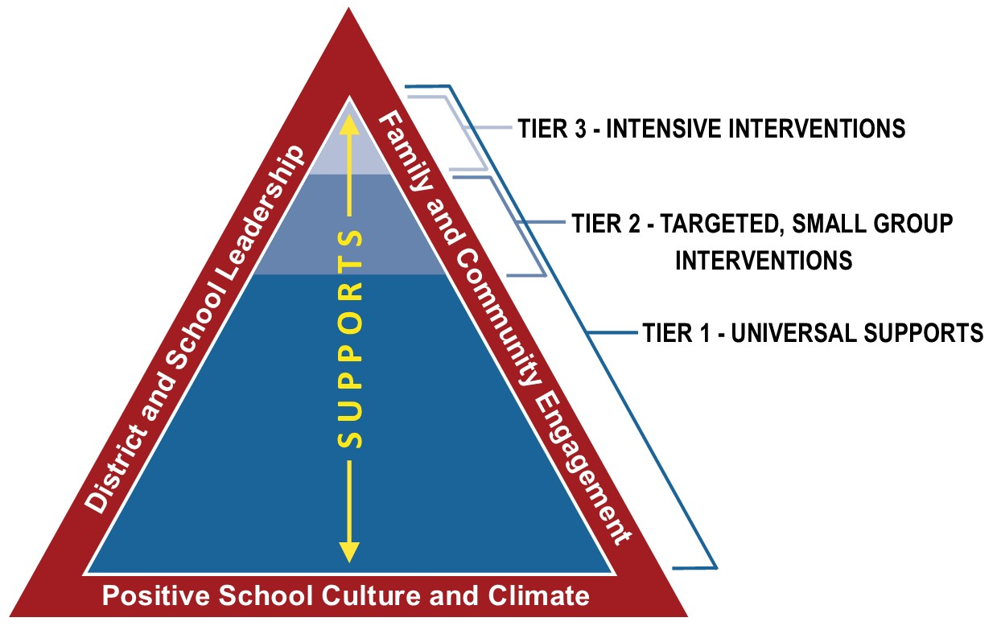
Mental Health Resource Guide Key Features
Practical examples of implementation – “School Spotlights”
Hyperlinked resources and templates within each chapter.
Clear guidance on how to fund school-based mental health initiatives.

Slide 32
How to Use this Guide
Use your district’s needs assessment and the Guide to improve identified targeted areas.
Determine what teams (data decision making, I&RS, etc.) you already have in place to support with implementation.
Identify your reading style to support your use of the Guide.
Use the chapter key’s corresponding icons throughout the Guide to help you navigate the Guide easily.

Slide 33
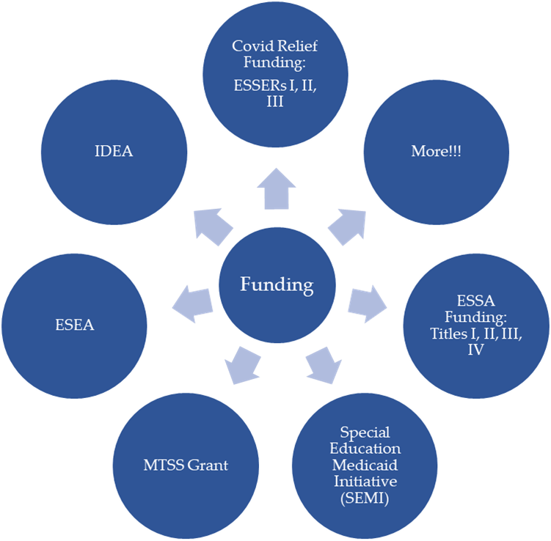
3 Strategies to Fund the Guide
Funding Strategy 1: Braid funds
Funding Strategy 2: Use data-based decision making
Funding Strategy 3: Establish community partnerships

Slide 34
Resources & Supports
Available Statewide
  New NJDOE website of mental health resources & additional guidance materials
  Office hours with the NJDOE’s mental health specialist
  Webinar series on school based mental health
  Roundtable sessions
Targeted
  Trainings & technical assistance
  Coaching supports to implement comprehensive school-based mental health supports
  Funding for school districts to conduct depression screenings with students

Slide 35
District Presentations

Slide 36

Paramus Summer Learning Academy Overview

Slide 37
Program Vision
The goal of the Paramus Summer Learning Academy is to meet the diverse needs of Paramus students to offset the impact of the pandemic by offering students a “study camp” that will:
Reach a wider range of students in need of academic support to remediate learning loss
Support students social and emotional needs
Strengthen community connections and student engagement with peers
Provide economic support by offering program at no cost

Slide 38
Program Overview
The cost of the program will be covered entirely by federal grant funding
All Paramus students are eligible to participate at no cost to families.
The program provides academic reinforcement of grade-level concepts as well as interest-based enrichment opportunities.
Both full-day and half-day program options available from June 28 through August 6
Transportation will be available at no cost.
Lunch will be available at no cost.
The entire K-12 program will be held at Paramus High School.

Slide 39
Program Structure and Schedule
Academics Only
8:30 - 11:30 am (no lunch)
8:30 - 11:45 am (no lunch)
Electives Only
12:00-3:00pm (no academics, no lunch, up to three 1 hour electives)
Full Day
8:30-3:00pm: academics, lunch, up to 3 electives

Slide 40
In-Person Summer Learning Academy:
2021 Enrollment
Students from Kindergarten through 11th grade participated in academic courses during the morning and enrichment electives during the afternoon.
Program | Enrollment
In Person Academics K-11 | 695
In Person Electives K-11 | 599
In Person Academics Only | 245
In Person Electives Only | 149

Slide 41
Academic Programming
The overall focus of the academics portion of the day was on providing supplemental support targeting key grade level skills and standards. While the teachers operated using a core curriculum, they heavily differentiated their instruction based on the needs of the students in their class.
The following is a breakdown of the specific program offerings by each grade level.
Grades | Academic Program
K-4 | Language Arts and Mathematics
5-8 | Language Arts and/or Mathematics
9-12 | Language Arts and/or Mathematics

Slide 42
Academic Expectations
Assessment-guided Instruction
  Administer Baseline assessment (See Curriculum)
  Keep records of both formative and summative assessments
  Be prepared to report on progress (narrative report card that will include both a progress update and suggestions for continued practice.)
  Be supportive and encouraging!

Slide 43
Enrichment Course Electives
With elective courses, the goal was to provide a wide variety of offerings to provide interest-based opportunities for enrichment experiences. After making their selection of their top five choices, students were scheduled for three electives each afternoon. The majority of students received at least two of their three top choices.
Course options included fitness, art, music, dance, theater, games, culinary arts, STEM activities, and other opportunities for socialization and personal growth and development.
Elective Catalog

Slide 44
Virtual Learning Academy
For anyone who was unable to participate in the in-person program, or for anyone interested in participating in both programs, the district also ran a Virtual Elementary Summer Learning Academy that offered a variety of choice-based enrichment courses with the goal of providing flexibility with scheduling through the virtual format.
District teachers developed course proposals for both content and timeframes and facilitated the courses through Google Meet.

Slide 45
Reflections and Next Steps
Summer Programming
What we learned from 2021
Where we’re headed in 2022

Slide 46
South Amboy Public Schools
Mr. Jorge Diaz, Superintendent of Schools
Dr. Christine M. Robbins, Director of PPS/C&I
Mr. Peter Frascella, Business Administrator

Slide 47
Advertised Enrollments (05/17/2021)
Pupil Enrollment Categories | 10-15-2019 Actual | 10-15-2020 Actual | 10-15-2021 Estimate
On Roll Regular Full-Time | 954.0 | 921.0 | 919.0
On Roll Special Ed Full-Time | 146.0 | 154.0 | 154.0
On Roll Special Ed Shared- Time | 2.0 | 1.0 | 0.0
Private School Placements | 7.0 | 2.0 | 0.0
Sent to Other Districts | 0.0 | 0.0 | 2.0
Sent To Other Districts SPED | 23.0 | 24.0 | 26.0

Slide 48
Allocations for South Amboy
Expenditures dated March 13, 2020 to June 30, 2021
ESSER Fund | Grant Name | Federal Category | Total Allocation | Total Expanded
CARES (ESSER I) | CARES | Mandatory | 217,886 | 206,598
CRRSA (EESER II) | CRRSA-ESSER II | Mandatory | 846,676
CRRSA (EESER II) | CR Learning Accreditation Grant | State set-aside | 54,335 | 0
ARP ESSER | CR Mental Health | State set-aside | 45,000 | 0
ARP ESSER | ARP ESSER | Mandatory | 1,902,850 | 0
ARP ESSER | Accelerated Learning Coaching and Enrichment Activities Grant | State set-aside | 105,157 | 0
ARP ESSER | Evidence-Based Summer Learning and Enrichment Grant | State set-aside | 40,000 | 0
ARP ESSER | Evidence Based Comprehensive Beyond School Day Activities Grant | State set-aside | 40,000 | 0
ARP ESSER | MTSS Mental Health Support Grant | State set-aside | 88,501 | 0
 |  |  | 3,340,405

Slide 49




State Set-Aside Funds
CARES
  Physical Health and Safety
    Expenditures in filtration/ventilation
    Masks/Face Shields
    Sanitizer and Floor Stands
    COVID screen testing
    Signage related to distance
    Contact tracing
    Cleaning and disinfection
    Thermometers (Infrared)
    Plexiglass Shields for Staff/Students

Slide 50

Parent/Student Reengagement
Parent Facilitator
Parent Workshops
Keystone online courses
Tutoring online
Mindfulness/Yoga Online

Slide 51
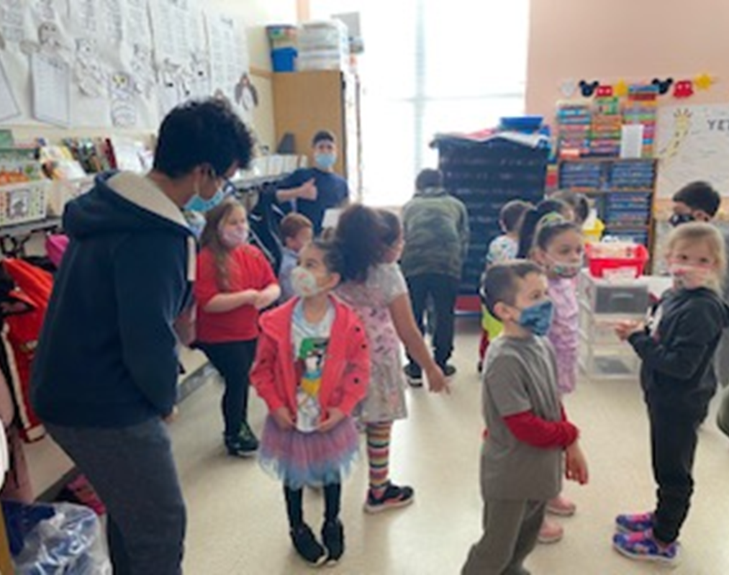
Reengaging Students
YMCA Activities
Field Trips
Wingman
Legends

Slide 52

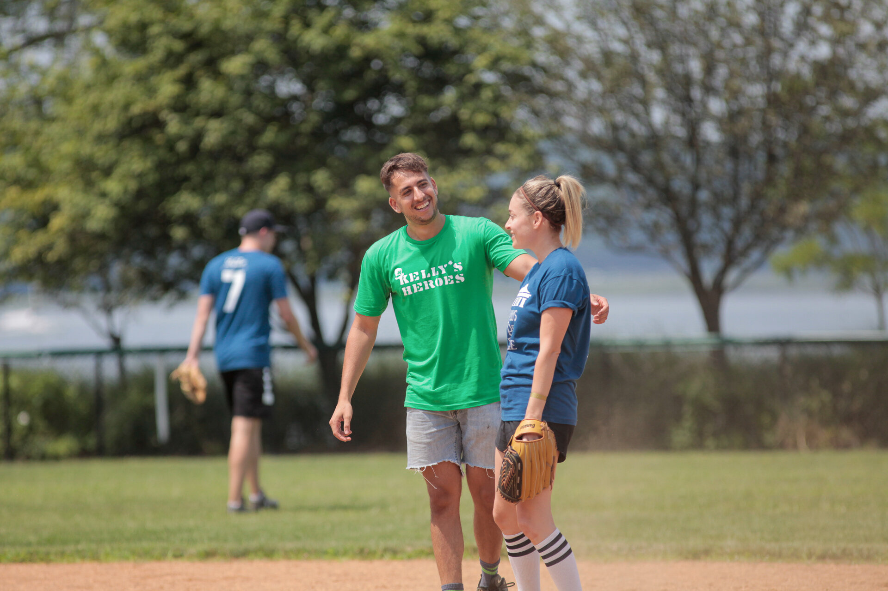
JCK Foundation (Legends Program)
DAY-LONG, HANDS-ON PROGRAM THAT INCLUDES TWO INTERACTIVE WORKSHOPS, MULTIPLE SMALL GROUP CONVERSATIONS AND STRESS MANAGEMENT TOOLS IN PARTNERSHIP WITH PASSKIT.
WHEN WAS THE FIRST TIME YOU HEARD THE TERM 'MENTAL ILLNESS?’
DESCRIBE A TIME A MEDICAL DIAGNOSIS CHANGED YOUR PERSPECTIVE ON A SITUATION.
IF YOU COULD REPLACE THE TERM 'MENTAL ILLNESS' WITH ANOTHER WORD OR SET OF WORDS, WHAT WOULD IT BE?

Slide 53



Internet Access
Chromebooks ($89,600.00)
Hot Spots
Instructional Online Programs
  Digitability (CARES)
  Literably (CARES)
  Rosetta Stone (CARES)
Online HS Student Courses
Professional Development Online
  Differentiated Instruction
  Assessment and Personalized Learning
  Fountas and Pinnell PD

Slide 54
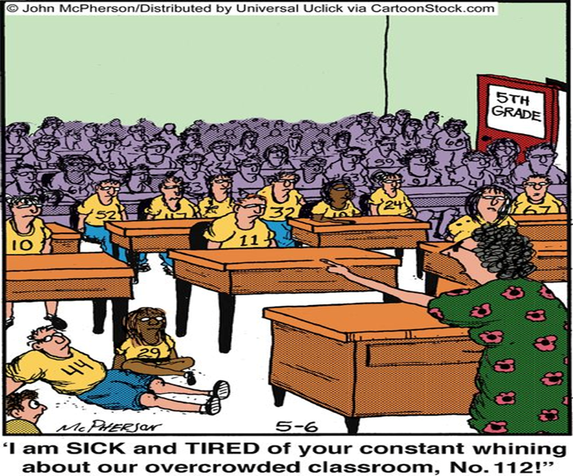
Hiring and Retention
Additional Staff Added:
Paraprofessionals (8)
ESL (1)
School Counselor (1)
Classroom Educators (40)
Support Personnel (1)
Summer Enrichment:
Summer Options
  $52,000 for staff
  $25,249.50 retirement, FICA
Learning Recovery (Keystone)

Slide 55

Wingman: Dylan’s Wings of Change
The first cohort of youth leaders trained in an organization costs $3,000 and each subsequent cohort is charged at $2,000 each, which covers:
Two full days of training per cohort of 20 youth leaders by a certified Wingman Trainer.
The one-day workshop for the adult mentors to thoroughly understand the program structure.
Access to more than 20 Wingman activities, with safe social distancing guidelines where needed.

Slide 56

CARE Solace ($5000) aka Addiction Treatment Technology LLC
How We Serve / K-12
Students with mental health and substance use challenges need to receive the right help at the right time. Care Solace has the solution for school systems.
Our highly specialized Care Companions™ match students, staff and families in need to verified, local service providers, securing appointments in days, not weeks or months.

Slide 57
Needs:
COVID 19 Health Requirements
Academic Continuity
Staff/Student/Parents RE-Engagement Needs
Social Emotional Needs

Slide 58


Burlington City Public School District
Dr. John Russell
Superintendent of Schools
Mrs. Sherry Knight
Director of Curriculum, Instruction, and Equity
2021-2023 Lighthouse District

Slide 59
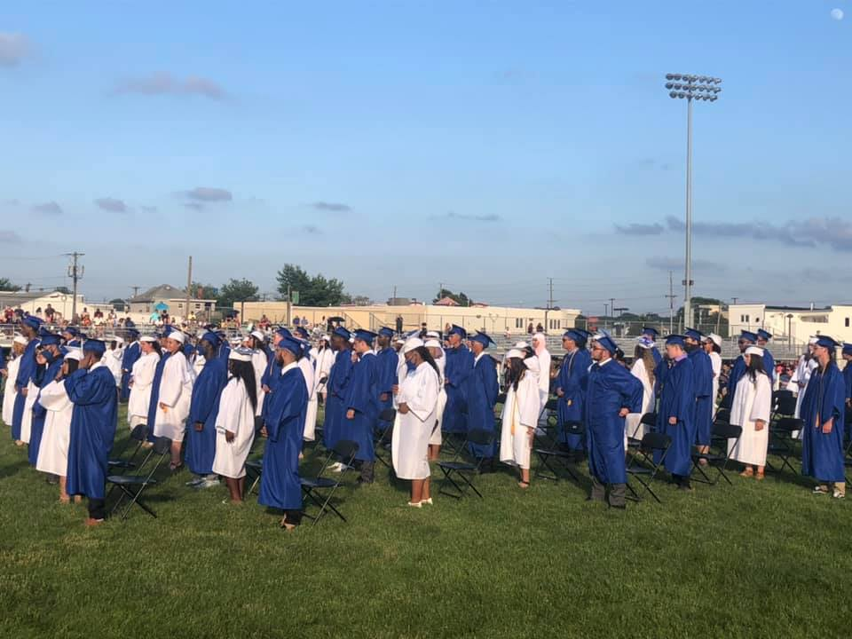
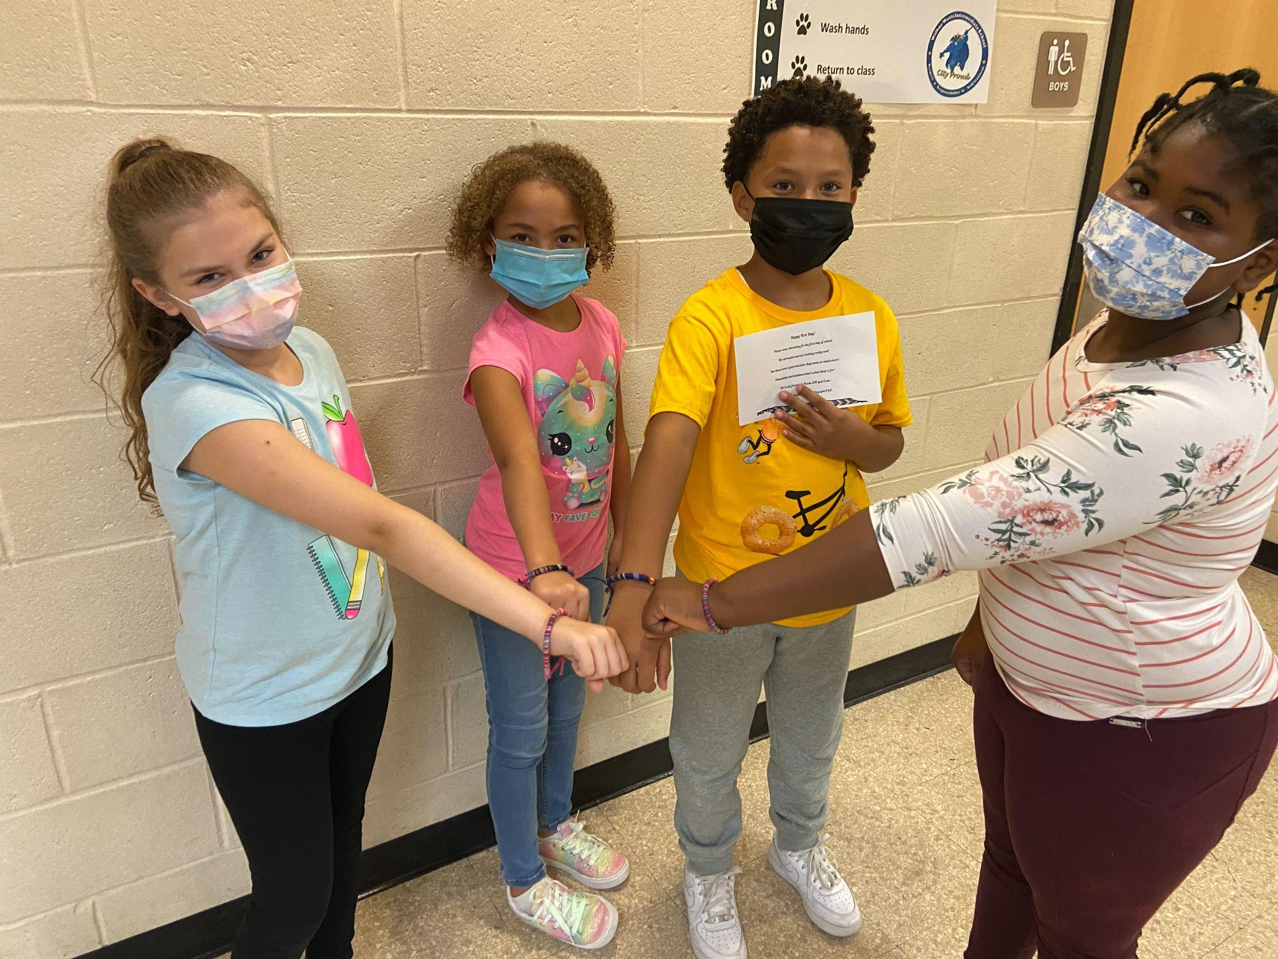
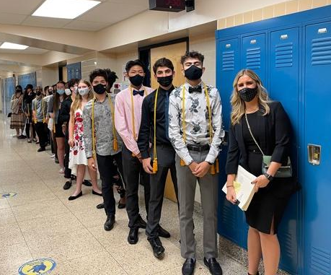
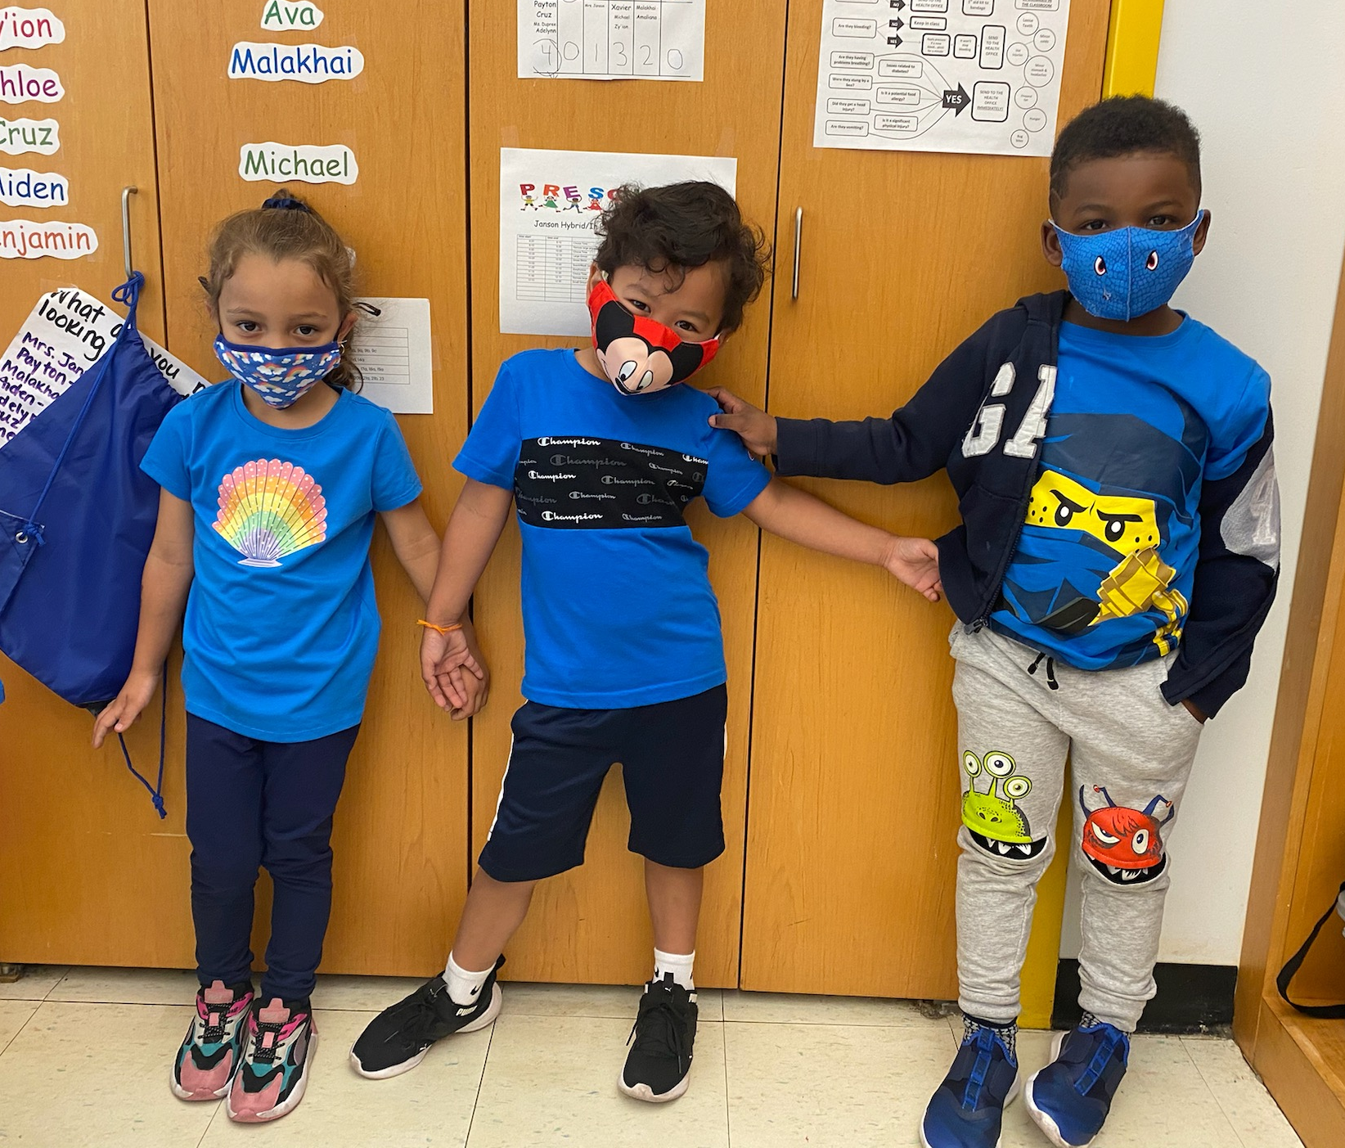
Demographics
Urban School District adjacent to the Delaware River
PK-12 District housed in 4 schools
Approximately 1,725 students
54.4% Economically Disadvantaged
20.4 % Students with Disabilities
5.5% English Learners
11:1 Teacher Ratio

Slide 60

Demographics Continued
Student Population
Male-52.0%
Female-48.0%
Black/African American-52.2%
White-26.8%
Asian-2.6%
Hispanic-16.2%
American Indian or Alaska Native-0.1%
Two or More Races-2.1%
Languages
English- 90.4%
Spanish-4.6%
Portuguese-1.6%
Other-3.4%

Slide 61
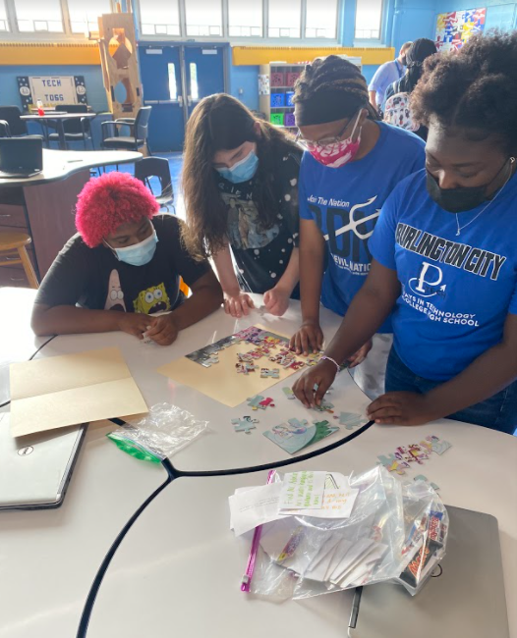
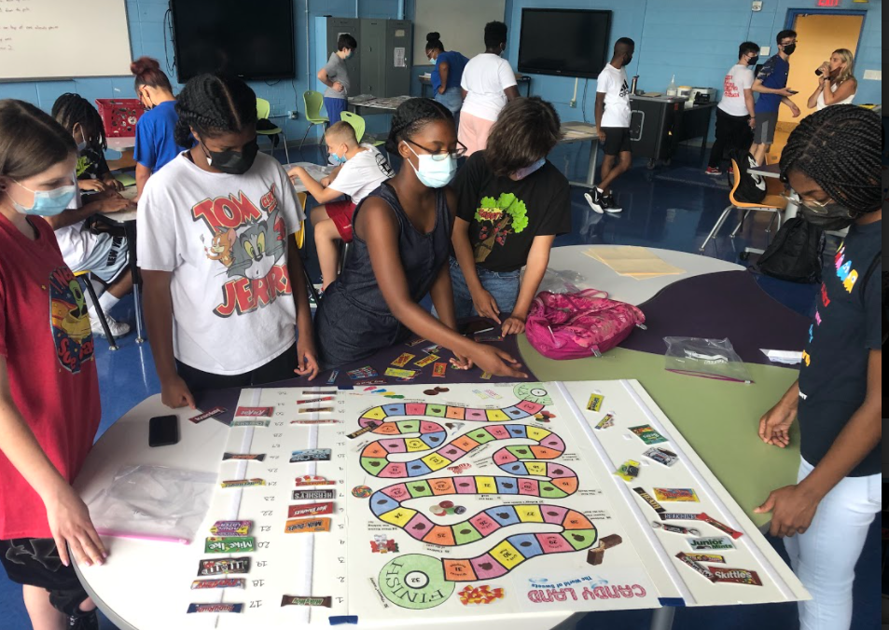
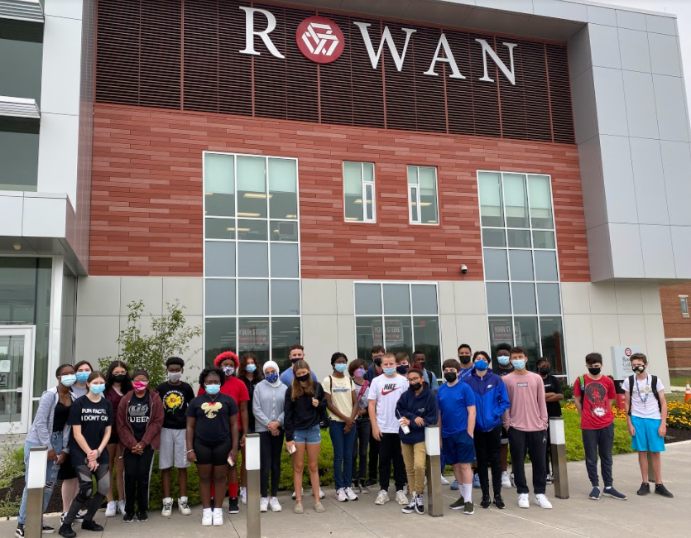
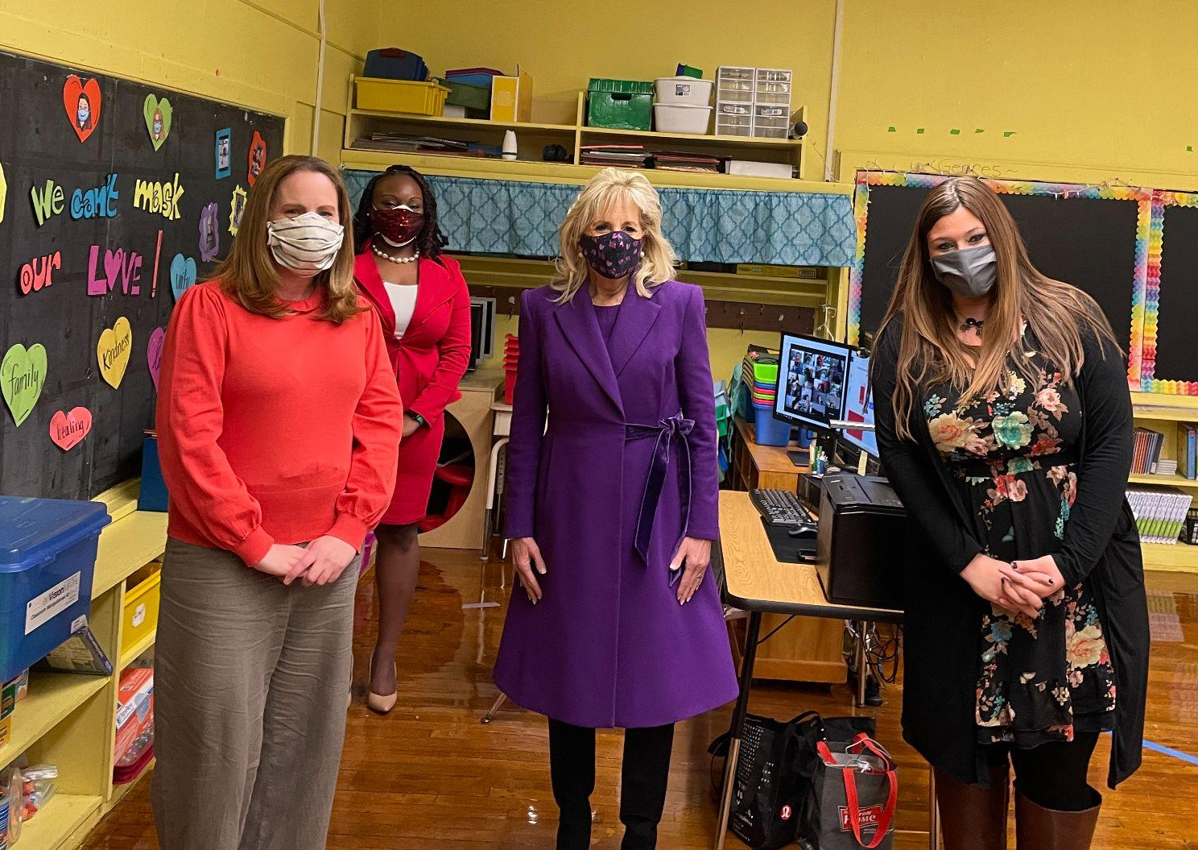
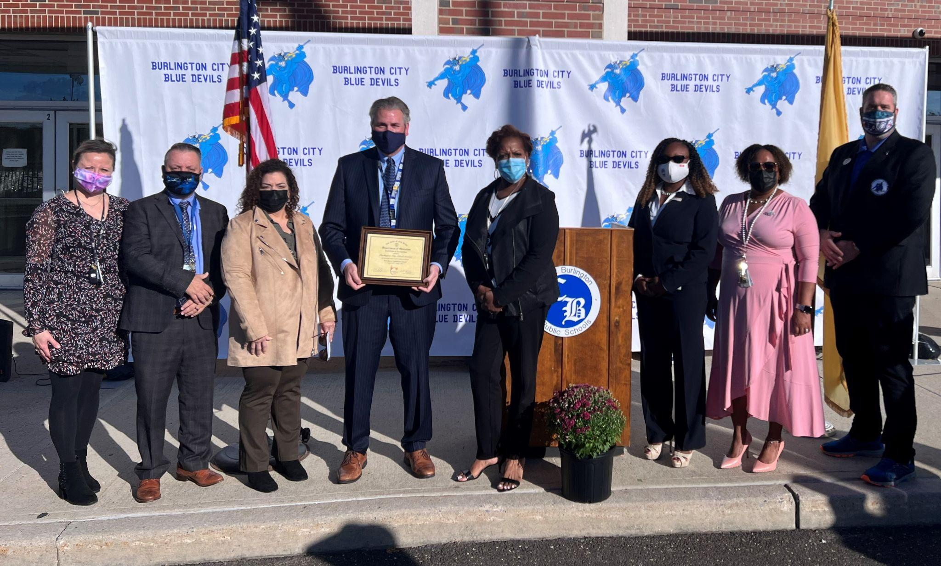
Highlights
NJ DOE Lighthouse Award Recipient 2021-2023
First Lady Dr. Jill Biden American Recovery Plan Visit
Pathways to Technology Early College (P-TECH) Grant Recipient

Slide 62
NJTSS Programs
Into Reading-researched based program in grades K-3 currently - implementation in grades 4-5 Fall, 2022
System 44/ Read 180 - year four of implementation targeted to increase reading fluency and comprehension
Underrepresented Students
Professional Development
  Orton-Gillingham Training- All teachers in grades K-2 are fully trained, one Special Education teacher, 2 at High School level

Slide 63


NJTSS Leadership Positions
Literacy Coach K-8
Supervisor of Guidance 7-12
Positive Behavioral Interventions and Support (PBIS) Coordinator & Facilitators
Growth Mindset Facilitators
Curriculum Facilitators

Slide 64
Other Programs & Supports
Extended School Day
Wordsmith, PAWS, S.T.E.M., Nuestro Mundo, Study Skills, Intensive Targeted Reading, Steps to Success, ELA Academy, Math Academy, and Science Academy
Extended School Year
PBIS
Credit Recovery Program and APEX Facilitator
Elementary Guidance Counselor
COVID-19 Coordinator

Slide 65

MindsetWorks
Growth Mindset program based on scientific research
Fixed vs. Growth Mindset about learning and intelligence
Instead of praising intelligence and talent, praise the process. Wisely praise effort, strategy, focus, improvement, and perseverance which in turn, builds resilience
“Yet” or “Not Yet” provides students with paths into the future
As students learn something new, neurons build stronger connections and they become more intelligent
Teachers currently participating in Professional Development in Motivating Mindsets, Messages that Motivate, The Malleable Mind, and Molding Mindsets
For the 2022-2023 School Year, the curriculum will be integrated into Health classes across the District

Slide 66
Wellness Wednesdays (1 of 2)
Collaboration of students, staff, and administration
Monthly initiative from January - June 2022
District-Wide Staff Survey - 95% of staff reported the first rollout was a productive use of time for students and staff
After student dismissal, approximately 63% of staff members utilized the afternoon to catch up on work in their classrooms and/or connect with colleagues
Many staff members reported that they appreciated being provided choices in how to spend their time and offered to share their own talents to support the well-being of their colleagues next month
The Tri-State Canine Response Team (therapy dogs) exclusively visit one building in the District each month on Wellness Wednesday

Slide 67

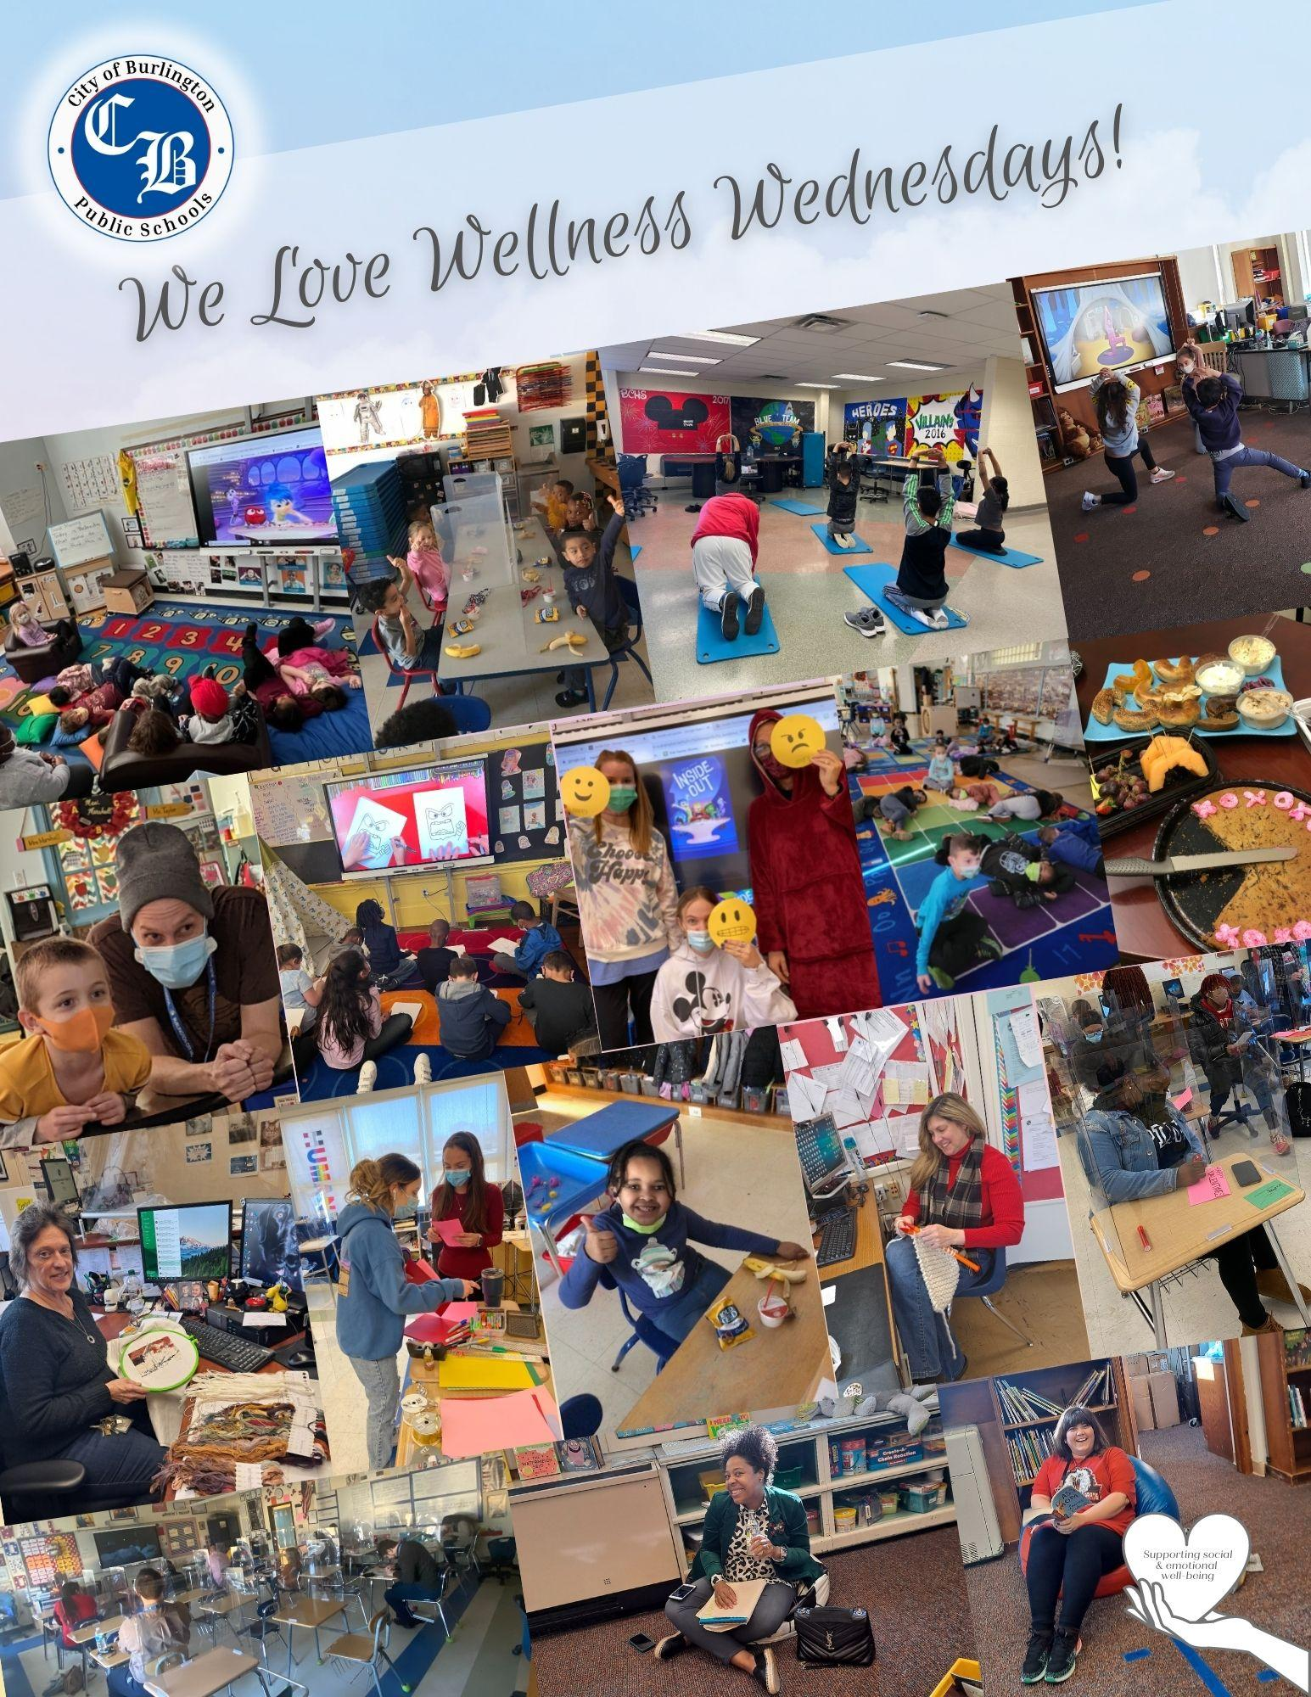
Wellness Wednesdays (2 of 2)

Slide 68
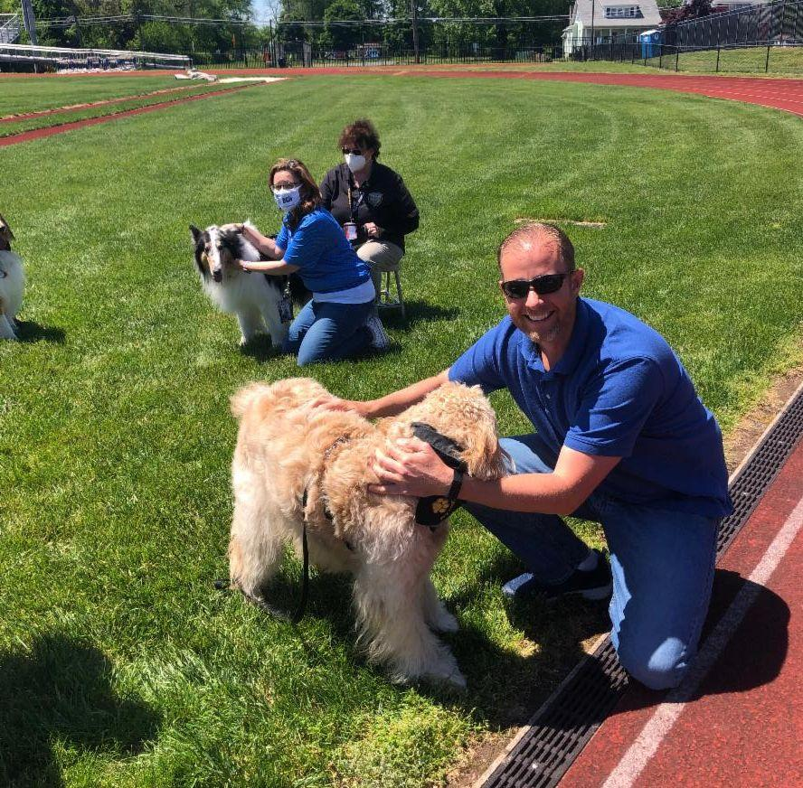
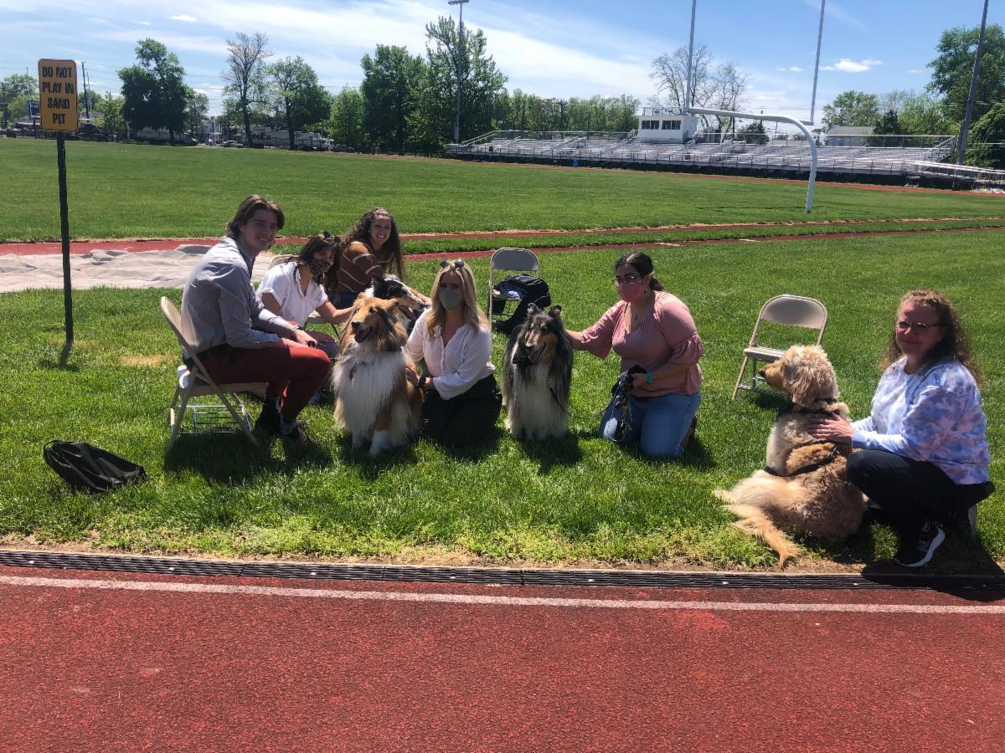
Therapy Dogs

Slide 69

Burlington City Public Schools - THIS IS US!!
Thank You for the Opportunity!
Question and Answers

Slide 70
Thank You!
New Jersey Department of Education Website
nj.gov/education
Questions may be submitted to:
ESSER@doe.nj.gov
Registration now open for the April 27, 2022, ARP ESSER Round Table
Follow Us!
Facebook:
@njdeptofed
Twitter: @NewJerseyDOE
Instagram:
@NewJerseyDoe

